Slide 1
DATA VISUALIZATION
R PROGRAMMING SELF LEARNING EVALUATION

Slide 2
WHAT IS R PROGRAMMING?
R is an open-source programming language that is widely used as a statistical software and data analysis tool. R generally comes with the Command-line interface. R is available across widely used platforms like Windows, macOS.
It has been adopted in the fields of data mining, bioinformatics, and data analysis.

Slide 3
IMPORTING DATA >placement=read.csv("C:/Users/SWAR/OneDrive/Desktop/r.csv",header=TRUE) >placement

Slide 4
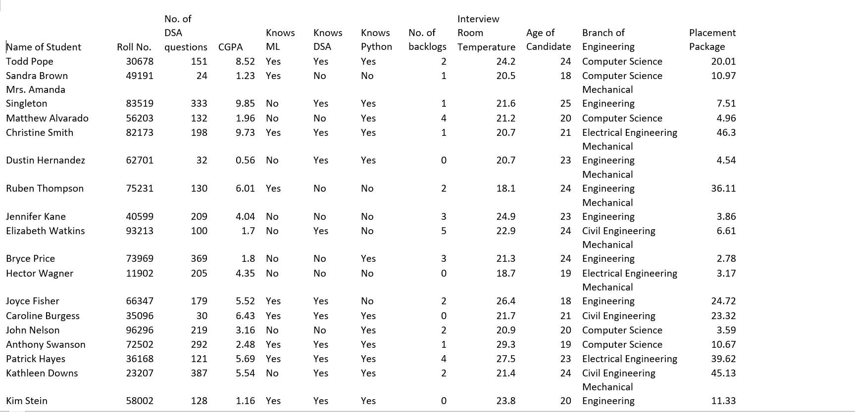

Slide 5
Columns :
Name of Student:
Description: The name of the student.
Data Type: String
Roll number:
Description: Roll number of the student.
Data Type: Integer
No. of DSA questions:
Description: The number of Data Structures and Algorithms (DSA) questions attempted by the student.
Data Type: Integer
CGPA:
Description: Cumulative Grade Point Average (CGPA) of the student.
Data Type: Float
Knows Ml
Description: Whether the student knows Machine Learning (ML) or not.
Data Type: String (Yes/No)
Knows Python: Description: Whether the student knows Python programming language or not. Data Type: String (Yes/No) No. of backlogs Description: Number of backlogs the student has. Data Type: Integer Age of Candidate: Description: Age of the student. Data Type: Integer Branch of Engineering: Description: The branch of engineering the student belongs to. Data Type: String Placement Package: Description: The package offered to the student during placement, in lakhs per annum. Data Type: Float

Slide 6
1 . Box plot graph of placement packages according to different branches of engineering. >ggplot(a,aes(x=Branch.of.Engineering,y=Placement.Package,fill=Branch.of.Engineering))+geom_boxplot()+scale_fill_manual(values=c("dark blue","red","orange","pink"))+theme(legend.text.position="top",plot.background=element_rect(fill="yellow"))+labs(title="BOX PLOT OF PLACEMENT PACKAGES BY ENGINEERING",x="Branch.of.Engineering",y="Placement.Package")
The Box Plot graph shown above represents the Placement packages according to the Branch of Engineering. The Bar plot shows the ratio of these to variables as in which branch has the highest package and which has the lowest package. We can easily observe that the branch of Electrical Engineering students have the highest placement package whereas the Computer science branch has lower placement package.

Slide 7
2 .BAR PLOT ACCORDING TO THE KNOWLEDGE OF STUDENT REGARDING MACHINE LEARNING AND PYHTON.
for machine learning
> ggplot(a,aes(x=Knows.ML,fill=Knows.ML))+geom_bar()+scale_fill_manual(values=c("dark green","cyan"))+labs(title="JOB PLACEMENT ACCORDING TO THEIR KNOWLEDGE OF ML ",x="Knows.ML",y="count")
The above Bar Plot displays the job placement of students according to their knowledge in Ml i.e Machine Learning . The X -axis represents the whether one knows Ml or not . And the Y-axis represents the count of te same . The colour Green represents the count of students not knowing Ml and the colour Blue represents the count of the students knowing Ml. We can observe that the students knowing Ml are slightly more than the students not nowing ML. Bar Plots are easy to understand and easy to analyse any data .

Slide 8
>ggplot(a,aes(x=Knows.Python,fill=Knows.Python))+geom_bar()+scale_fill_manual(values=c("red","green"))+labs(title="JOB PLACEMENT ACCORDING TO THEIR KNOWLEDGE OF PYTHON ",x="Knows.Python",y="count")
2. for python
The Bar Plot garph shown above displays the count of the job placement on the basis of whether the candidate knows Python or not. The X-axis represents
Whether the candidates know Python or not and the Y-axis represents the count for the same . As we can see that the colour Green represents the
Students not knowing Python and the colour Blue represents the students knowing Python . According to the analysis we can conclude that the count
Of students knowing Python and not knowimg Python are almost equal.

Slide 9
3 . Pie chart of branches of engineering
>ggplot(a,aes(x="",fill=Branch.of.Engineering))+geom_bar(width=1,color="black")+coord_polar("y",start=0)+labs(title="PIE CHART OF BRANCHES OF ENGINERING",fill="Branch.of.Engineering")+theme_void()+scale_fill_manual(values=c("purple","dark green","maroon","cyan"))+theme(legend.text=element_text(size=10,color="brown"),legend.title=element_text(face="bold"))
The graph shown above is a Pie Chart of Branches of Engineering.
The Pie Chart shown above gives us information about the proportion of the branches of the engineering. There are 4 branches in total ,namely Computer
Science , Civil ,Electrical and Mechanical . The proportion is almost equal of all the four branches . Civil engineering and Mechanical engineering are
Slightly more as compared to the other two.

Slide 10
4 . area chart of job placement by roll no and cgpa
>ggplot(a,aes(x=Roll.No.,y=CGPA,fill=Branch.of.Engineering))+geom_area()+scale_fill_manual(values=c("green","blue","red","yellow"))+theme(legend.position="top",legend.text=element_text(size=10,color="brown"),legend.title=element_text(face="bold"))+labs(title="AREA CHART OF JOB PLACEMENT BY ROLL NO AND PLACEMENT PACKAGE",x="Roll.No.",y="CGPA",fill="Branch.of.Engineering")

Slide 11
The above Area Chart represents the Job placement of students roll.no and their CGPA . The x axis represents the Roll.no of the students and the y axis represents the CGPA of the students. The different colours in the chart represents the various branches of Engineering such as Computer Science, Civil Engineering, Electrixal engineering and Mechanical engineering. The graphical representation simply gives us the information of each student and his/her CGPA in different branches.

Slide 12
THANK YOU!

